Slide 1


Slide 2
The Scott CPU - 1
The Heart of the Computer

Slide 3
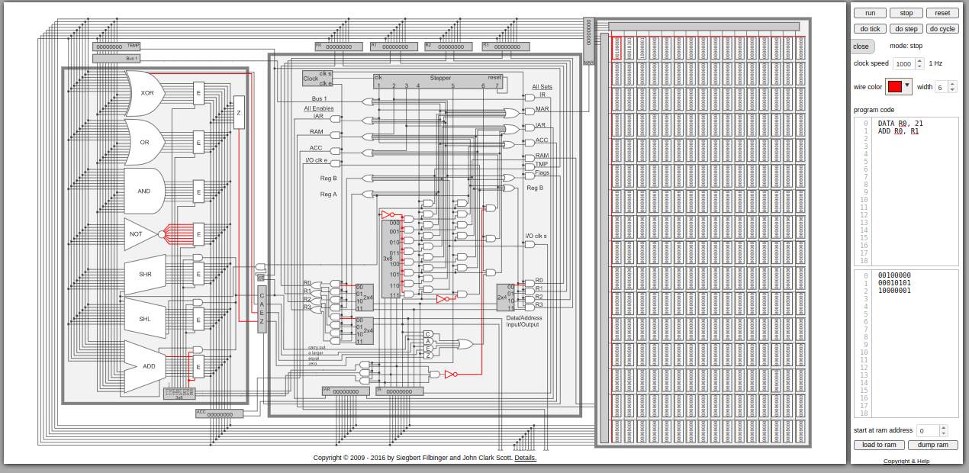
Last Lecture
In the last lecture we discussed
The general Von Neumann architecture
The general CPU layout
The ALU
Registers
The Control Unit
Memory
Notes:
Can be found online… but I can’t link to it

Slide 4
Today
In the next three lectures we are going to do a deep dive on a simple CPU: The Scott CPU
8-bit
4 registers
256 memory slots
Primitive assembly language
Very simple (well, kinda…)
Notes:
Can be found online… but I can’t link to it

Slide 5
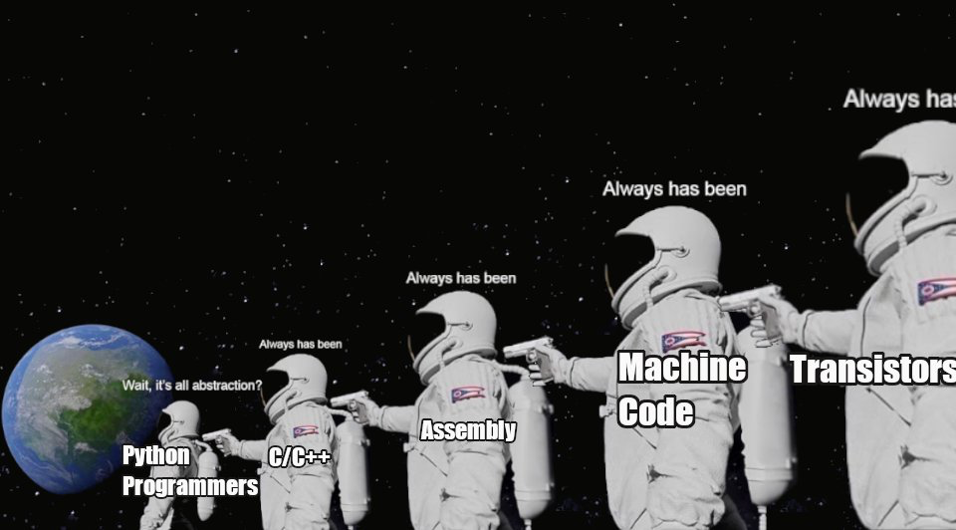
Always Remember…

Slide 6
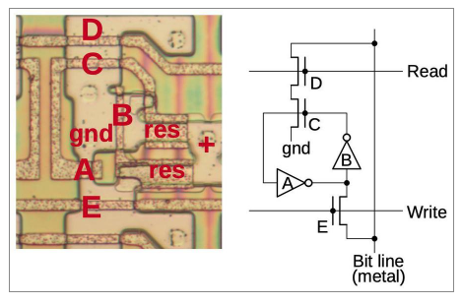
Registers
Recall the lecture where we discussed how to store a single bit in an 8080 chip
In the Scott CPU there are several registers:
R0-R3 (general registers)
IAR - Instruction Address Register
AKA “The Program Counter”
IR - Instruction Register
Notes:
Can be found online… but I can’t link to it

Slide 7
Registers
In the Scott CPU there are several registers:
TEMP - temporary register
ACC - Accumulator register
MAR - Memory Address register
The Scott CPU doesn’t have a MDR (Memory Data Register) because data is moved directly from RAM into destination registers
Unrealistic but makes things easier to understand
Notes:
Can be found online… but I can’t link to it

Slide 8
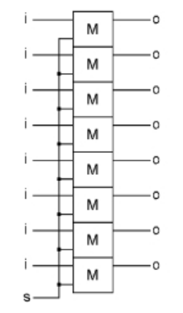
Registers
In the Scott CPU, registers are made up of a series 8 one bit storage units (labeled M) in parallel
Note that there is a “set” line labeled “s”
Notes:
Can be found online… but I can’t link to it

Slide 9
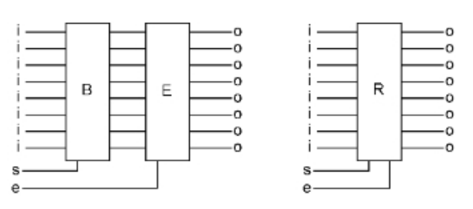
Registers
The ‘s’ line, when enabled, takes the value from the bus (discussed in a moment)
There is also an enable line (labeled “e”) that puts the value of the register onto the bus
Together, all these features make up a register
Notes:
Can be found online… but I can’t link to it

Slide 10
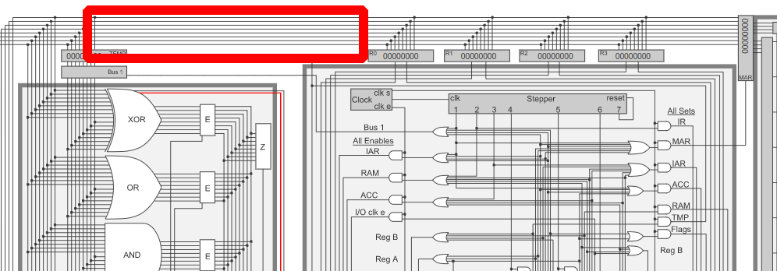
The Bus
In the Scott CPU there is an 8-bit bus that connects all components
Recall the “bit line” when we were looking at an 8086 registers
This “bus” is just a set of “wires” that connects everything together
Notes:
Can be found online… but I can’t link to it

Slide 11
The Bus
To “move” data from one place to another:
The source memory location is enabled to place its value on the bus
The destination is set to take the new value
The source is disabled
On the Scott CPU this general series of operations is the same for both memory locations and registers
Notes:
Can be found online… but I can’t link to it

Slide 12
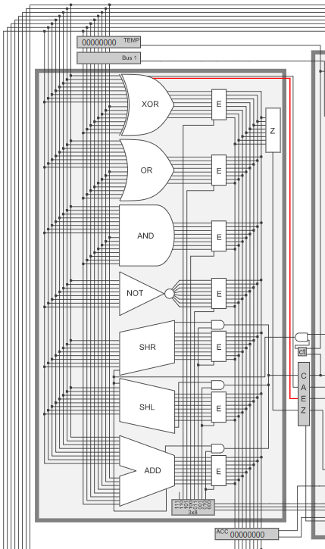
The ALU
The ALU is the logical unit of the CPU
Actually pretty simple
A collection of logical operators on the 8 bits
A temporary input register
Some wiring to enable one of the operations
A bit of wiring for the flags register
An output register (The accumulator!)
Notes:
Can be found online… but I can’t link to it

Slide 13
The ALU
The ALU is the logical unit of the CPU
The flags register is used to store comparison values
Greater than
Equal
Zero
etc
The flags and accumulator registers are where the results of computations in the ALU end up
Notes:
Can be found online… but I can’t link to it

Slide 14
The ALU
What about these operations we have available in the ALU?
XOR, OR, AND, NOT
Bitwise logical operations
SHR, SHL
Bitwise shift operations
ADD
Binary integer addition
E.g. a ripple adder like we saw earlier
Notes:
Can be found online… but I can’t link to it

Slide 15
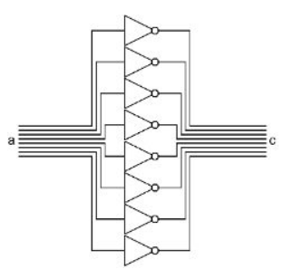
The ALU
NOT Implementation
Note, only one input
“Not” is a unary rather than binary operation
Again, pretty simple
For each bit, apply a logical not
Remember: we know how to make a NOT out of a NAND
And we know how to make a NAND out of transistors
And we know how to make transistors out of sand
Notes:
Can be found online… but I can’t link to it

Slide 16
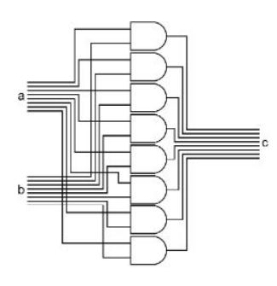
The ALU
OR, XOR and AND Implementations
Binary operations, take two values as inputs
For each bit, apply the given logical operation
At right, we see the ANDer
The first bits of A and B are anded, etc...
Notes:
Can be found online… but I can’t link to it

Slide 17
The ALU
OR, XOR and AND Implementations
Remember: we know how to make an AND NOT out of a NAND
And we know how to make a NAND out of transistors
And we know how to make transistors out of sand
Notes:
Can be found online… but I can’t link to it

Slide 18
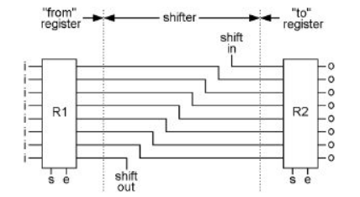
The ALU
SHIFT Implementation
As with NOT, only one input
Shifts are unary
Could not get any simpler! No logical gates are even required!
Note that there is a carry bit that will go out to our flags register
Notes:
Can be found online… but I can’t link to it

Slide 19
The ALU
What does a left shift do? 0000 0010 - 2 decimal 0000 0100 - 4 decimal
Well, what happens if you “shift” a decimal number to the left? 0000 0050 0000 0500
Notes:
Can be found online… but I can’t link to it

Slide 20
The ALU
Shifting is also useful for bit masking
If you want to test the value of a single bit in a byte, you can shift the value 1 to that and then bitwise-AND the bit with the value
Notes:
Can be found online… but I can’t link to it

Slide 21
The ALU
A basic bitwise test
0101 0100 - to test
0000 0001 - value 1
0000 0100 - 1 << 2
0000 0100 - bitwise AND of value 1 and value 3
if(value 4 is not 0) there was a bit in position 3 of value 1
Notes:
Can be found online… but I can’t link to it

Slide 22
The ALU
ADDER Implementation
Addition requires two inputs, so a binary operator
The adder here uses the basic the digital addition logic we covered earlier
8 full adders wired up in parallel to add the values up
Notes:
Can be found online… but I can’t link to it

Slide 23
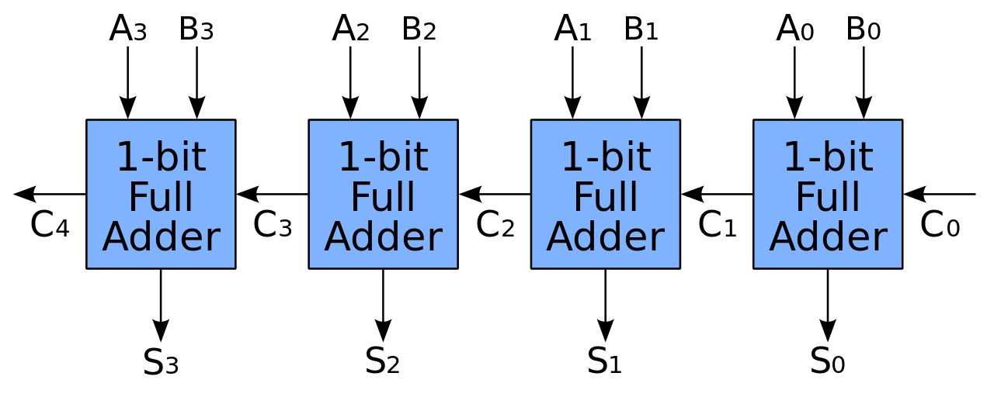
The ALU
ADDER Implementation
Addition requires two inputs, so a binary operator
The adder here uses the basic the digital addition logic we covered earlier
8 full adders wired up in parallel to add the values up
Notes:
Can be found online… but I can’t link to it

Slide 24
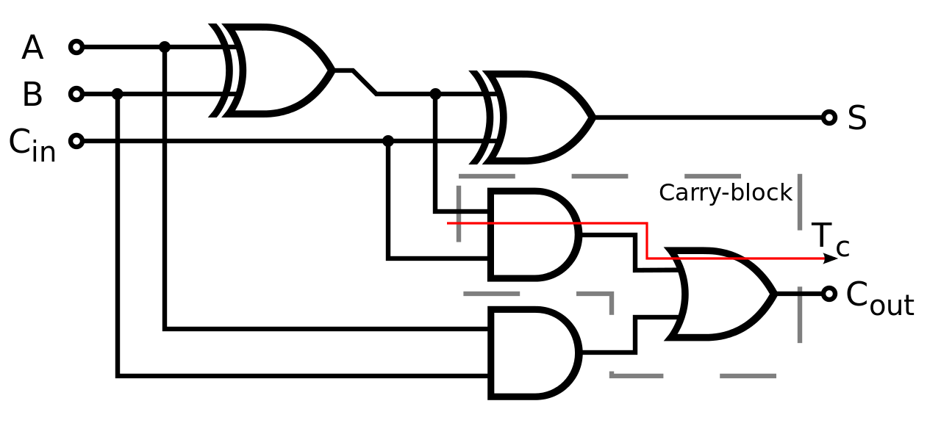
The ALU
ADDER Implementation
Addition requires two inputs, so a binary operator
The adder here uses the basic the digital addition logic we covered earlier
8 full adders wired up in parallel to add the values up
Notes:
Can be found online… but I can’t link to it

Slide 25
The ALU
ADDER Implementation
Remember: we know how to make all these logical gates out of a NAND
And we know how to make a NAND out of transistors
And we know how to make transistors out of sand
We have a rough understanding of how this CPU works all the way down
Notes:
Can be found online… but I can’t link to it

Slide 26
The ALU
Additional stuff
XOR can be used to detect equality and greater than booleans, set into the flags register
Zero is detected on output and placed into the flags register
Bus 1 is some logic to put the binary value 1 on the bus
Notes:
Can be found online… but I can’t link to it

Slide 27
The ALU
Note the gates labeled E
These are enabler gates
Depending on which operation the control unit turns on, one of the operations will be enabled
Notes:
Can be found online… but I can’t link to it

Slide 28
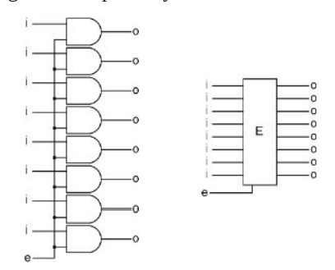
The ALU
Here is what an enabler looks like logically
A series of AND gates, hooked up to the enable signal as well as the input
Notes:
Can be found online… but I can’t link to it

Slide 29
The ALU
By placing this gate between the operation and the bus, the computer controls which value flows out to the accumulator
Notes:
Can be found online… but I can’t link to it

Slide 30
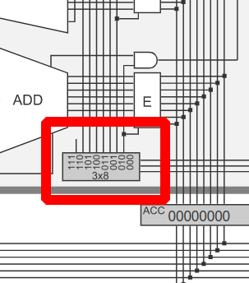
The ALU
A bit of control logic in the lower part of the ALU is responsible for activating the correct enabler
How does that work?
Input 000 - Adder enabled
Input 001 - Orer enabled
Etc.
This is a 3x8 decoder
Notes:
Can be found online… but I can’t link to it

Slide 31
The ALU
Decoder
Takes n input bits
Sets one output bit from 2^n options
Recall n bits can represent 2^n numbers
A decoder will be referred to as nx(2^n)
E.g. 2x8
Notes:
Can be found online… but I can’t link to it

Slide 32
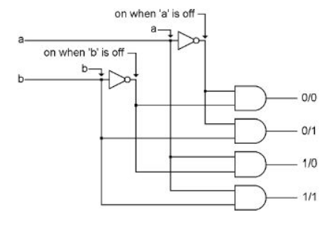
The ALU
Here is a 2x4 decoder
0/0 - first wire is on
0/1 - second wire is on
1/0 - third wire is on
1/1 - fourth wire is on
This simple circuit can be used with enablers to select from 4 different operations
Notes:
Can be found online… but I can’t link to it

Slide 33
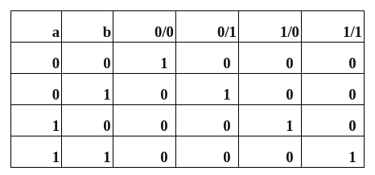
The ALU
Here is the 2x4 decoder truth table
We will also see a decoder when we look at the memory subsystem
Notes:
Can be found online… but I can’t link to it

Slide 34
The ALU
And that’s the whole 8 bit ALU!
Not so bad, is it?
A lot going on, but considered individually and ignoring some of the details, all pretty easy to understand
Notes:
Can be found online… but I can’t link to it

Slide 35
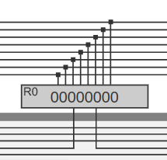
Registers
General purpose registers are quite simple in the Scott CPU
They are connected to the bus
The have a SET and an ENABLE input
When SET is on, the register takes the value from the bus
When ENABLE is on, the register puts its value on the bus
Notes:
Can be found online… but I can’t link to it

Slide 36
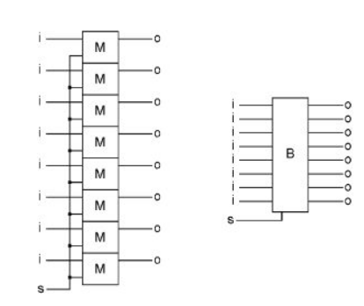
Registers
Internally we have eight of our little memory bits that we discussed previously
Each is connected to one wire on the bus
A set line is connected to the memory slots
When the set line is enabled the memory is updated to whatever is on the bus
Notes:
Can be found online… but I can’t link to it

Slide 37
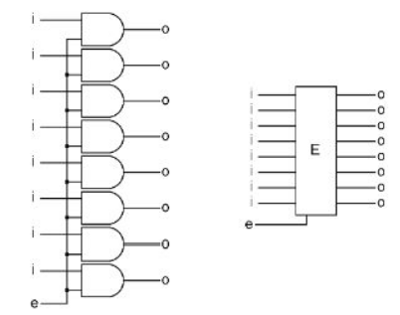
Registers
On the other side we have a bunch of AND gates wired to an enable line
When the enable line is, er, enabled, the memory bits will be placed on the bus
Notes:
Can be found online… but I can’t link to it

Slide 38
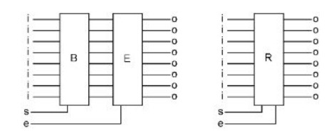
Registers
Combining these two circuits gives us our register
A place to store binary values
A way to set the value from the bus
A way to put the value onto the bus
Notes:
Can be found online… but I can’t link to it

Slide 39
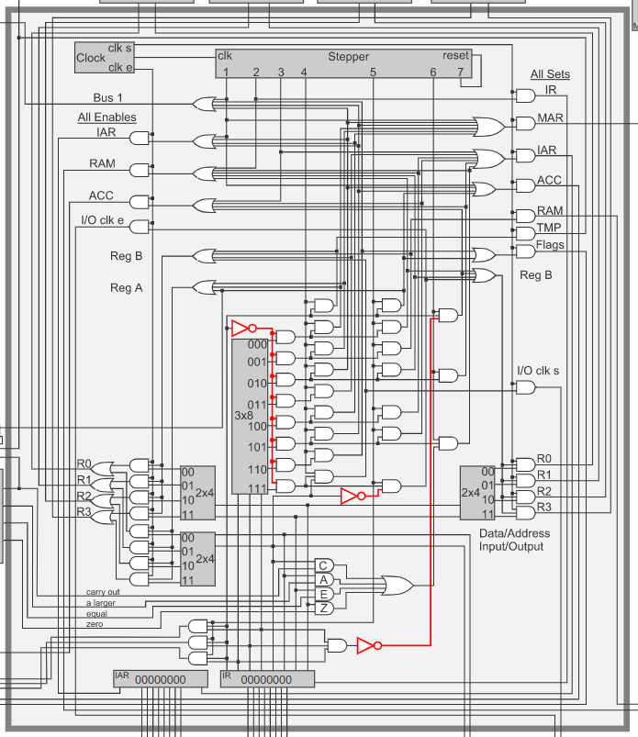
The Control Unit
The Control Unit is the most complex part of the Scott CPU
Responsible for managing the rest of the computer
At a high level, the ALU:
Reads an instruction
Enable the correct gates to execute that instruction
Repeats
Notes:
Can be found online… but I can’t link to it

Slide 40
The Control Unit
A slightly lower level way to think about the CPU:
For any given “step”, the goal is to move an 8 bit value from one memory location to another memory location
Where “move” can also involve a transformation of the value through the ALU
ENABLE one memory location onto bus
SET another memory location to that value
Notes:
Can be found online… but I can’t link to it

Slide 41
The Control Unit
Control Unit Components
Clock
Stepper
Instruction Address Register
Instruction Register
And then a bunch of logic… ;)
Notes:
Can be found online… but I can’t link to it

Slide 42
The Control Unit
Note that visually the Scott CPU is broken up into two functional areas
Enables on the left
Sets on the right
Ignore the details for now, just notice that we can enable and set various places in the CPU
Registers, ACC, RAM, IAR
Notes:
Can be found online… but I can’t link to it

Slide 43
The Control Unit
Registers
IR - Instruction Register Holds the current instruction
IAR - Instruction Address Register Holds the address of the current instruction
Notes:
Can be found online… but I can’t link to it

Slide 44
The Control Unit
The Clock
The clock emits three signals
clk - A normal tick
clk e - An enable signal that lasts 1 and ½ ticks
clk s - A set signal that lasts ½ of a tick
Note that the clk e is attached to all the enable-side logic
And, correspondingly, the clk s signal is tied to the set-side logic
Notes:
Can be found online… but I can’t link to it

Slide 45


The Control Unit
The Clock
Clock design
Signal needs to turn on and off at a certain rate
Conceptually this can be done by hooking a not gate back into itself, and giving the “wire” a long enough path to travel
Notes:
Can be found online… but I can’t link to it

Slide 46
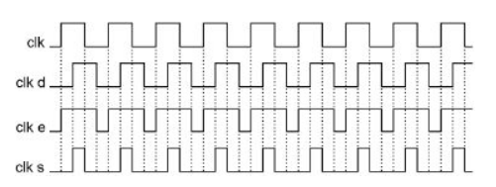
The Control Unit
The Clock
Creating the other two signals, clk e and clk s, involves taking two clocks and ANDING/ORING them together
A second clock, clk d, is half-offset from clk
clk e is clk OR clk d
clk s is clk AND clk d
Notes:
Can be found online… but I can’t link to it

Slide 47
The Control Unit
The Clock
Note that this sets things up perfectly for “moving” data between memory locations
clk e enables some memory location onto the bus
Half a tick later clk s sets that data into a particular location
Half a tick later clk s goes to 0, closing the set window
Finally, another half a tick later, clk e closes the enable window
Notes:
Can be found online… but I can’t link to it

Slide 48
The Control Unit
OK, that’s it for now!
But we’ve already learned about how roughly 60% of the CPU works
Next time we will discuss how the memory sub-system works, that funny stepper thingie, and how the Scott CPU decodes instructions
Fun!
Notes:
Can be found online… but I can’t link to it

Slide 49
The CPU
Today we discussed aspects the Scott CPU architecture
The bus is responsible for transmitting values between various memory locations
The ALU (arithmetic logic unit) is responsible for implementing
We looked at how to implement many of the common functions in an ALU at the logical level
There are four simple registers in the Scott CPU
The Control Unit is responsible for coordinating the rest of the chip
We discussed the basic layout and the clock
Next time we will discuss the remainder of the control unit as well as memory

